Slide 1
CO 2
Session no. 19

Slide 2
PATH VECTOR ROUTING
Path vector routing is similar to distance vector routing. There is at least one node, called the speaker node, in each AS that creates a routing table and advertises it to speaker nodes in the neighboring ASs..
The topics discussed in this section include:
Initialization
Sharing
Updating

Slide 3
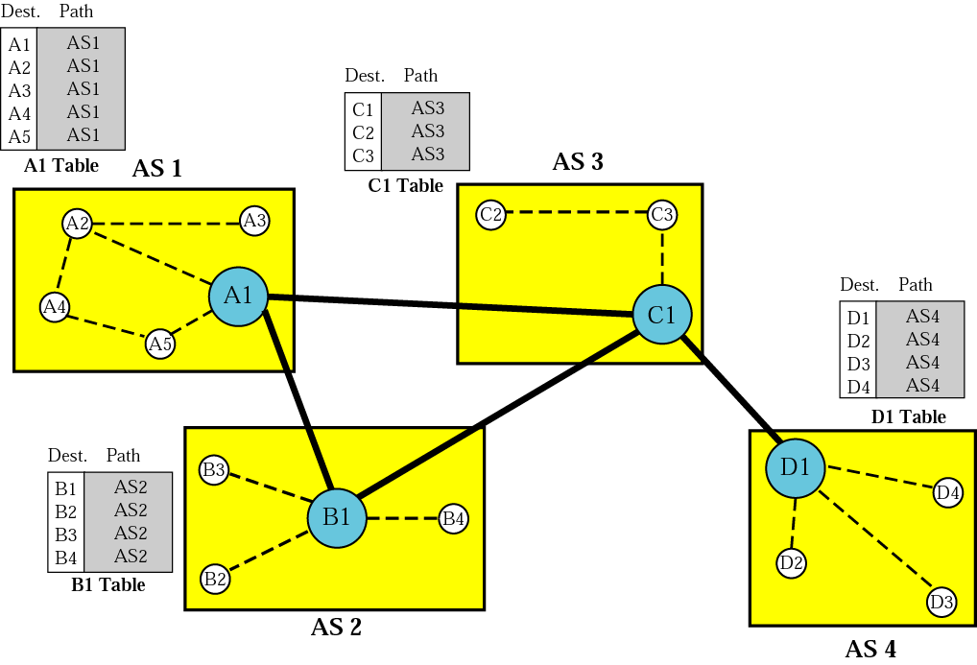
Figure Initial routing tables in path vector routing

Slide 4
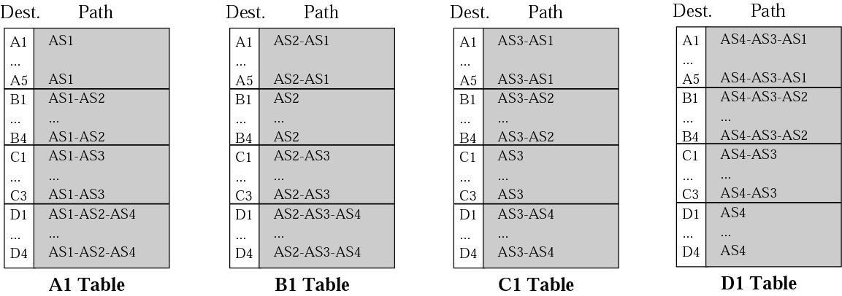
Figure Stabilized tables for four autonomous systems

Slide 5
BGP
Border Gateway Protocol (BGP) is an interdomain routing protocol using path vector routing. It first appeared in 1989 and has gone through four versions.
The topics discussed in this section include:
Types of Autonomous Systems
Path Attributes
BGP Sessions
External and Internal BGP
Types of Packets
Packet Format
Encapsulation

Slide 6
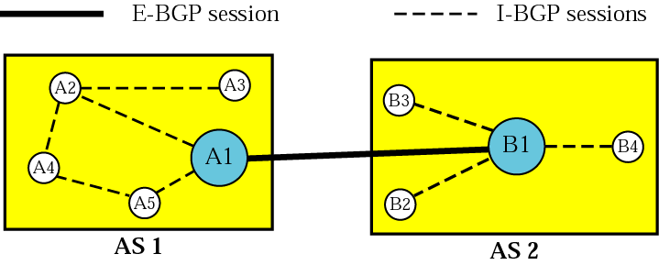
Figure Internal and external BGP sessions

Slide 7
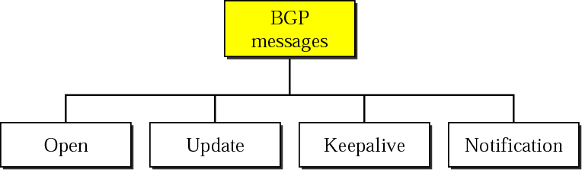
Figure Types of BGP messages

Slide 8
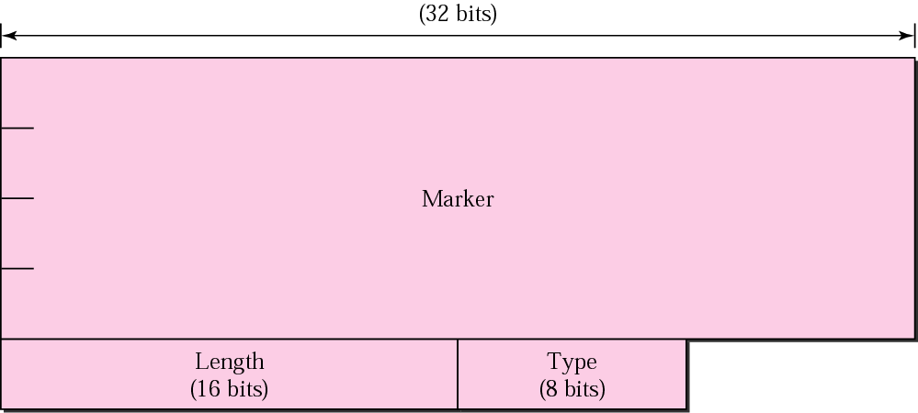
Figure BGP packet header

Slide 9
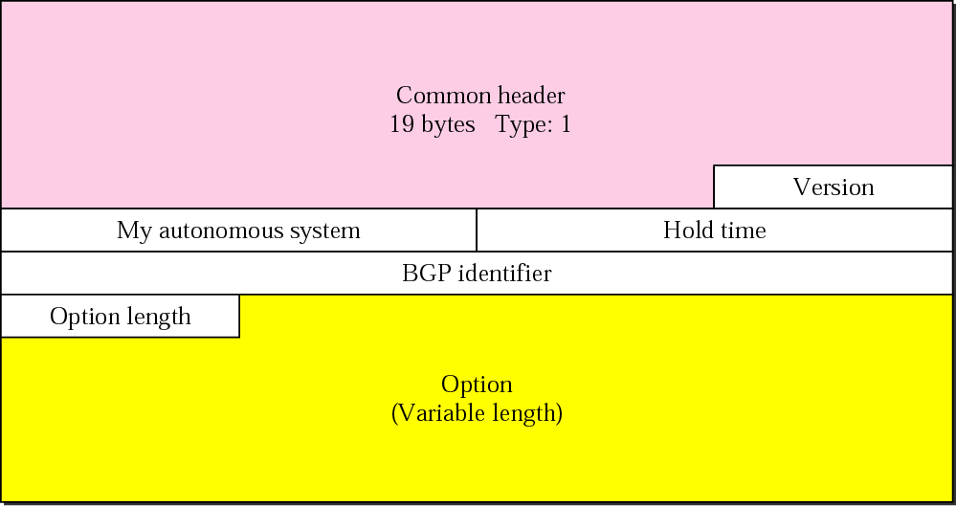
Figure Open message

Slide 10
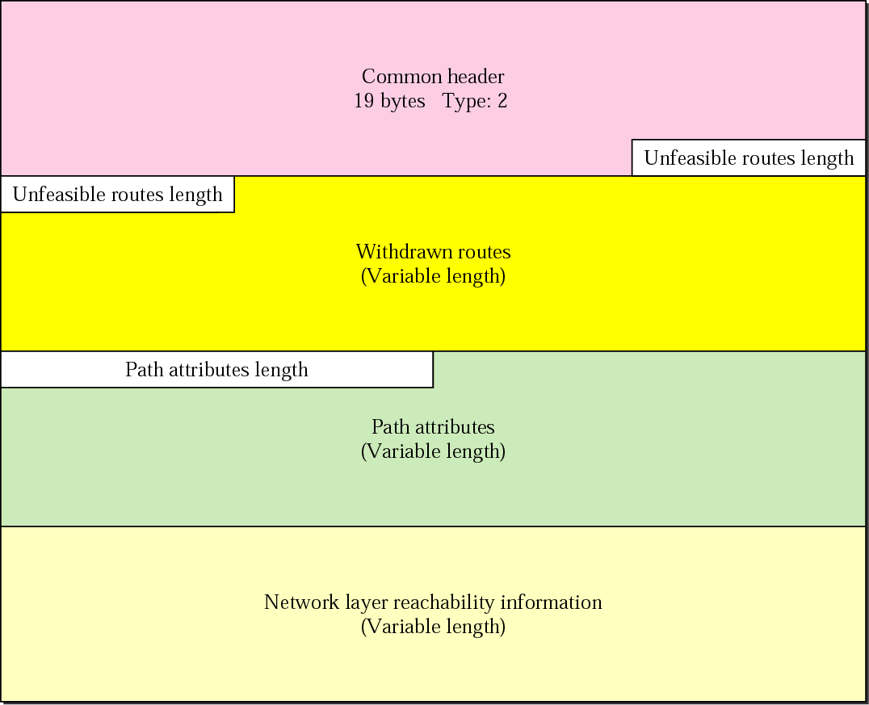
Figure. Update message

Slide 11
Note:
BGP supports classless addressing and CIDR.

Slide 12

Figure. Keepalive message

Slide 13
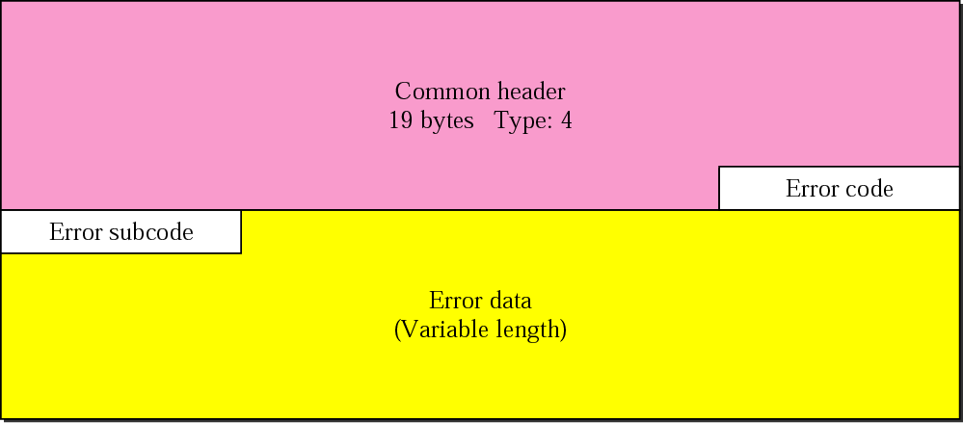
Figure. Notification message

Slide 14
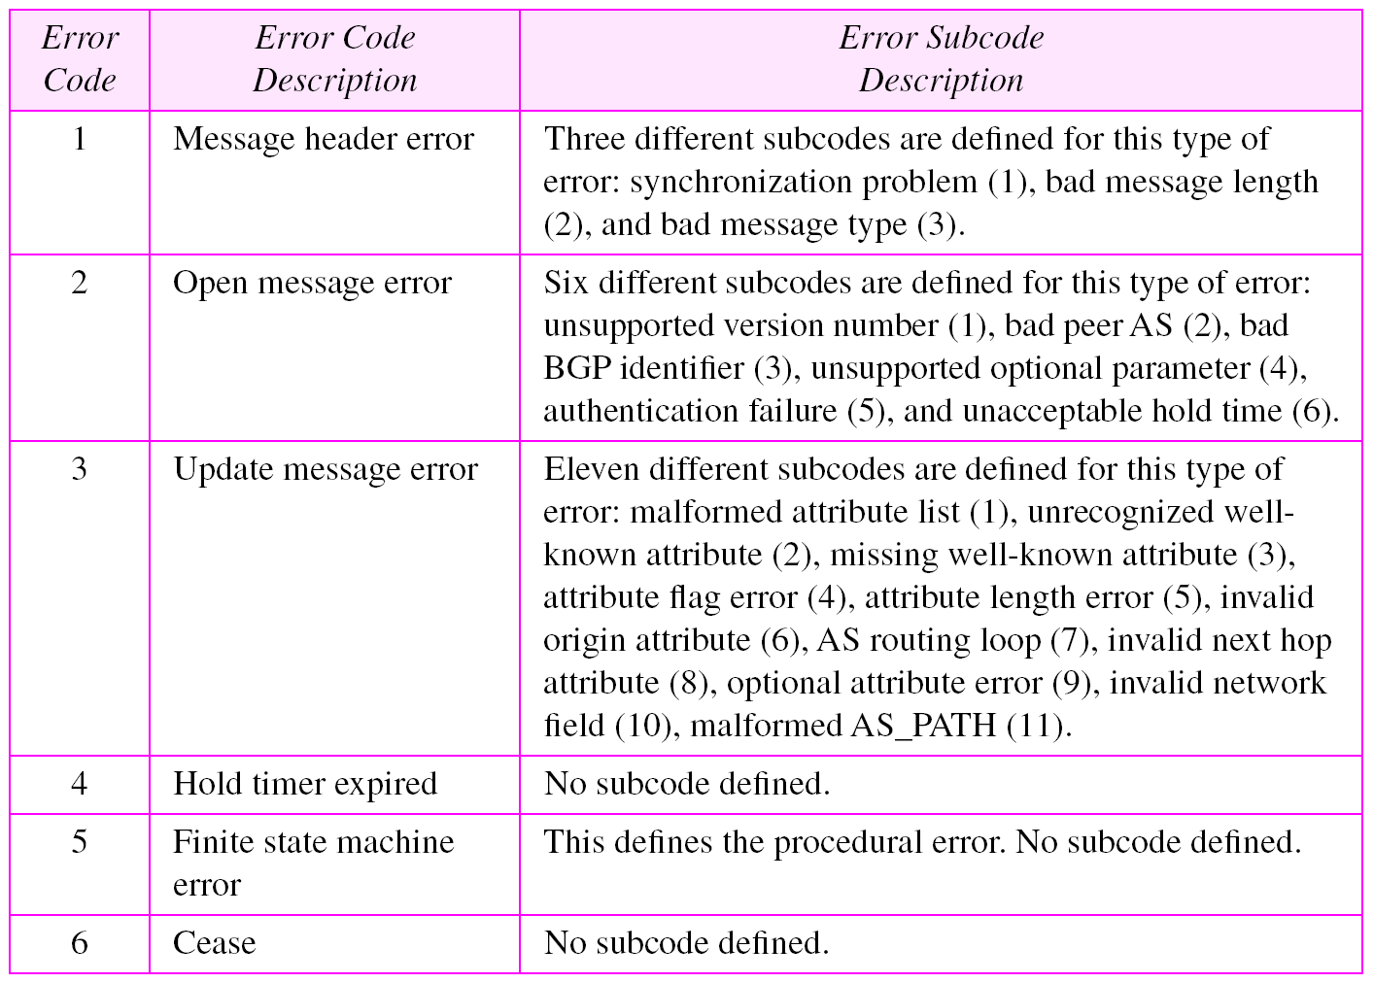
Table Error codes

Slide 15
Note:
BGP uses the services of TCP on port 179.

